Slide 1

Swap4U
T1A3 - Terminal Application
Anon Jaloenklung

Slide 2

About
This app is to survey customers opinions and feelings about ambient Ads media.
The app is creating to communicate with customers and advertisements.
It will benefit from using this information to improve and meet the needs of more customers.

Slide 3

Features
Member system [ Signup and Login ]
Admin system [ add and edit content in the survey ]
Collect data from user
Muti - Choice survey
Expect Feature
Notification Email

Slide 4

Challenges
A chaotic problem with starting with coding.
Low my coding skill.
Testing
Stuck with login, signup and survey because have to do many tasks.

Slide 5

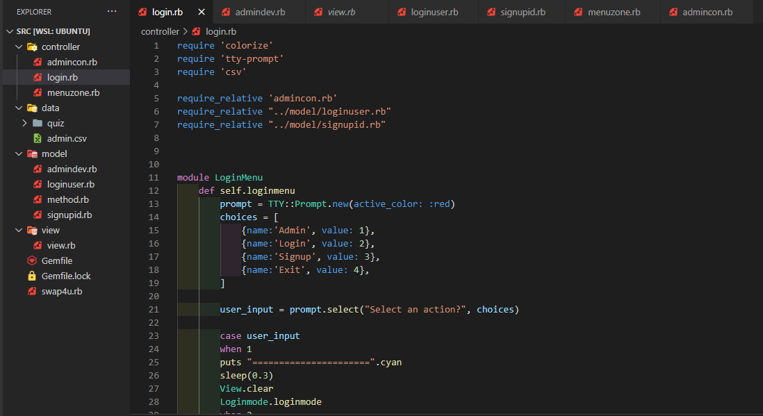
Demo

Slide 6
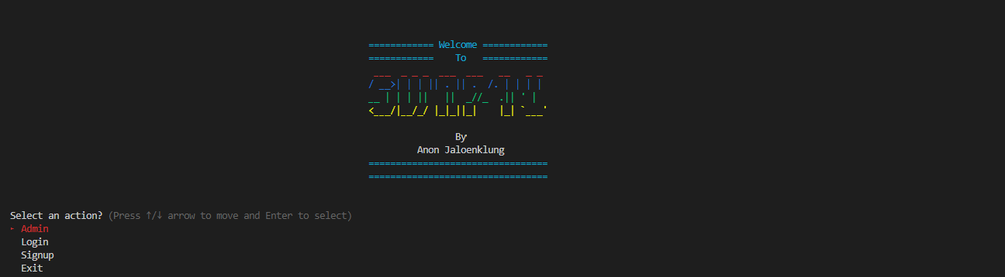
Demo

